Slide 1
IRREGULAR VERBS
PAGE 165 5.58
ENGLISH FILE ELEMENTARY THIRD EDITION

Slide 2
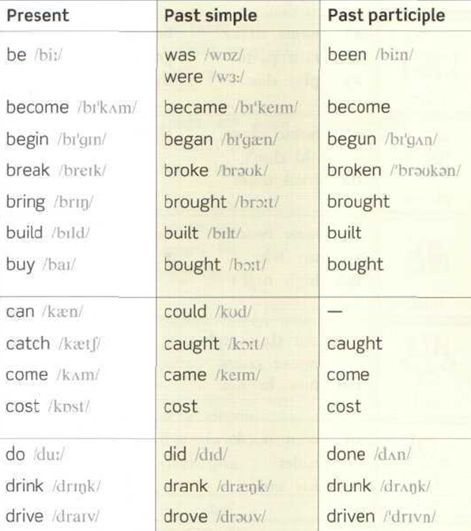


Slide 3
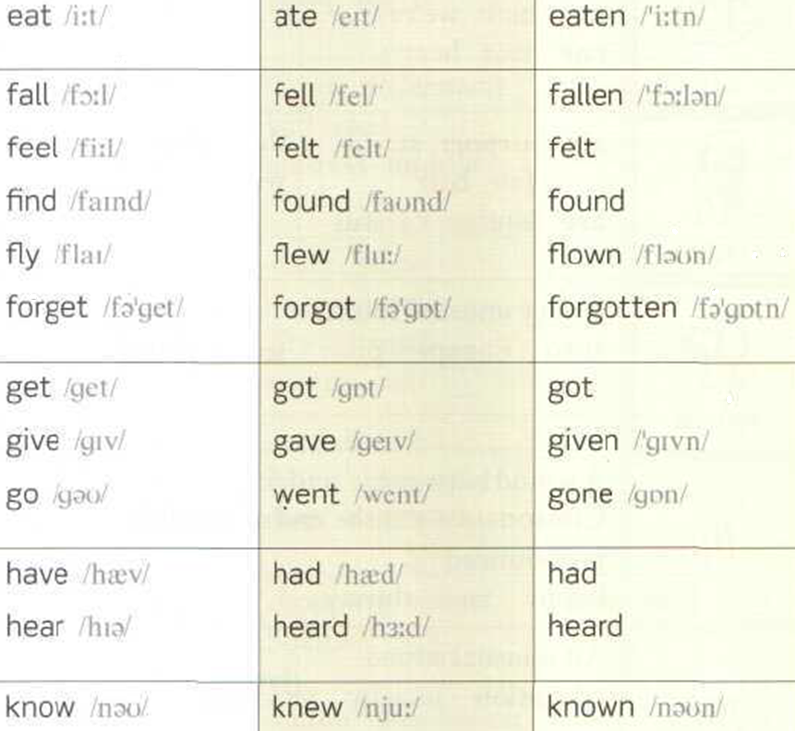

1.10

Slide 4

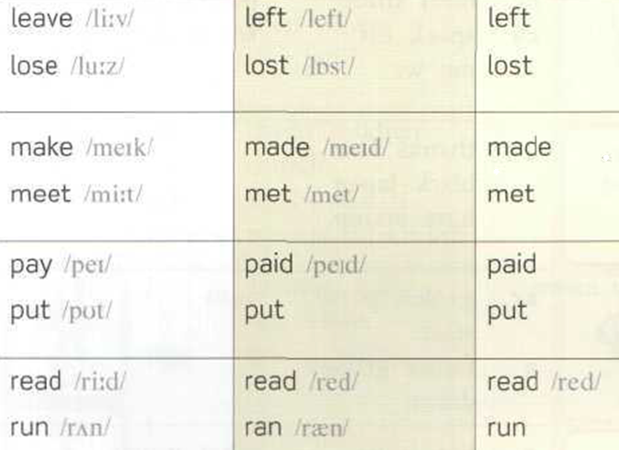
2.08

Slide 5
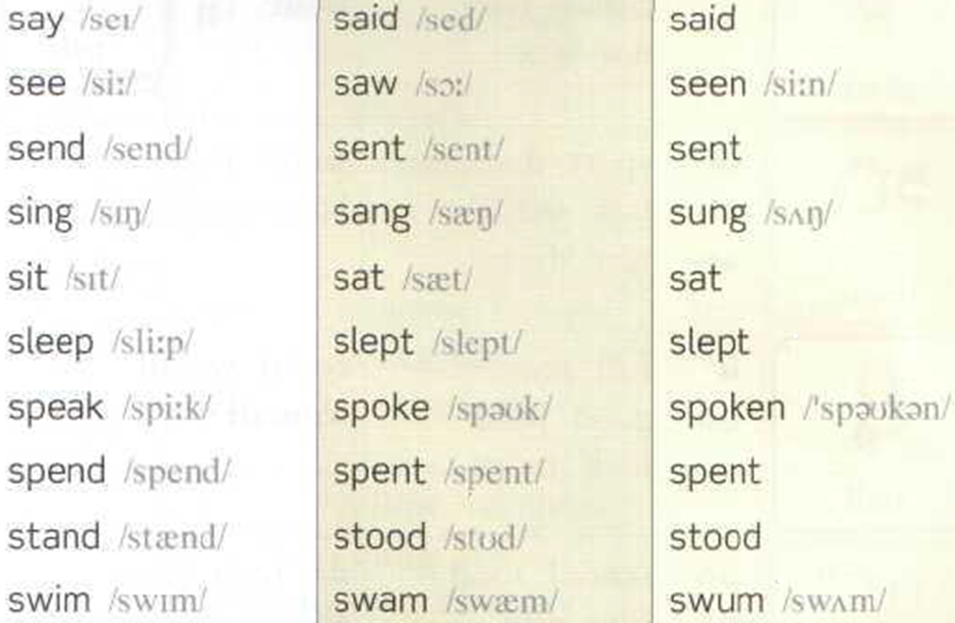
2.50

Slide 6
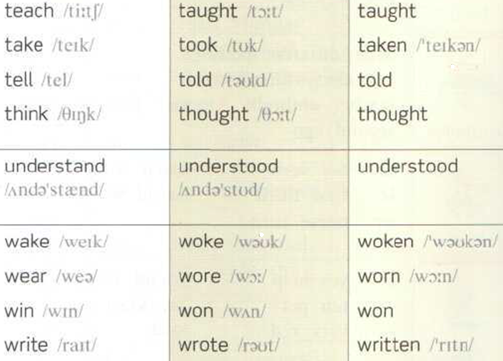
3.35

Slide 7
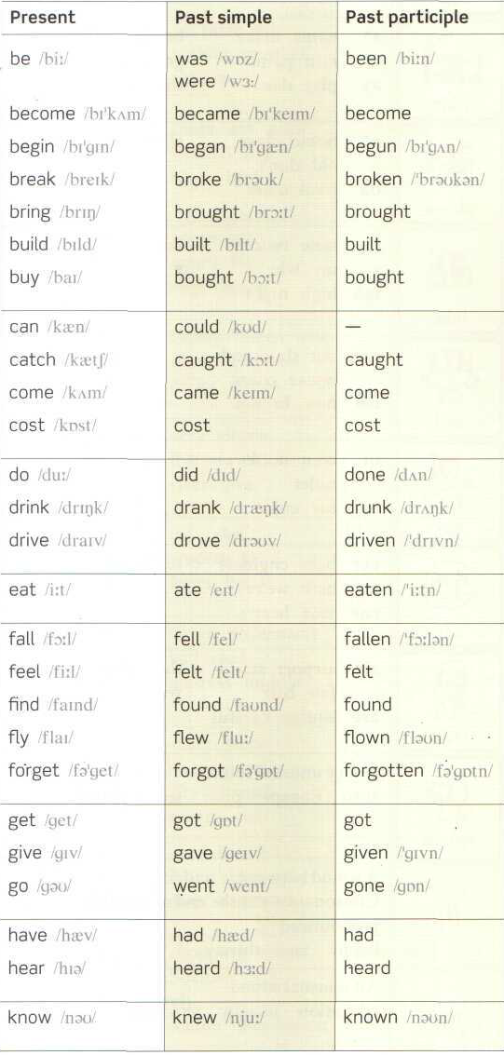
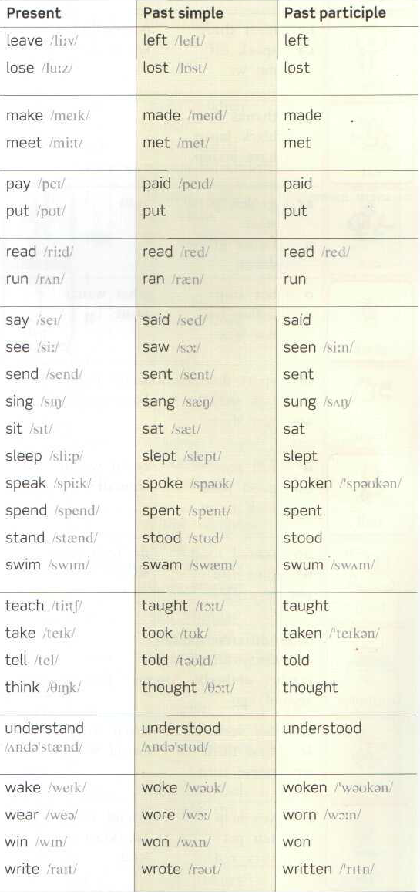

Page 165
Listen, Repeat and Memorize the three forms of all the irregular verbs. Present,
Past and
Past participle.
(You already know the past)

Slide 8
cost | cost | cost
put | put | put
read | read /red/ | read /red/

Slide 9
do | did | done
go | went | gone

Slide 10
become | became | become
come | came | come
run | ran | run

Slide 11
begin | Began | begun
drink | drank | drunk
sing | sang | sung
swim | swam | swum

Slide 12
break | broke | broken
drive | drove | driven
eat | ate | eaten
fall | fell | fallen
forget | forgot | forgotten
get | got | got (gotten)
give | gave | given
see | saw | seen
speak | spoke | spoken
take | took | taken
write | wrote | written
wake | woke | woken
wear | wore | worn

Slide 13
bring | brought | brought
buy | bought | bought
catch | caught | caught
teach | taught | taught
think | thought | thought

Slide 14
tell | told | told
build | built | built
feel | felt | felt
find | found | found
get | got | got
have | had | had
hear | heard | heard
leave | left | left
stand | stood | stood
lose | lost | lost
make | made | made
meet | met | met

Slide 15
spend | spent | spent
pay | paid | paid
say | said | said
send | sent | sent
sit | sat | sat
sleep | slept | slept
understand | understood | understood
win | won | won

Slide 16
fly | flew | flown
know | knew | known
draw | drew | drawn

Slide 17
BE am – is - are | BE was were | been
can | could

Slide 18
https://elt.oup.com/student/englishfile/elementary3/grammar/file12/grammar09_a01?cc=ar&selLanguage=en
https://elt.oup.com/student/englishfile/elementary3/grammar/file12/grammar09_a02?cc=ar&selLanguage=en
https://elt.oup.com/student/englishfile/elementary3/grammar/file12/grammar09_b01?cc=ar&selLanguage=en
https://elt.oup.com/student/englishfile/elementary3/grammar/file12/grammar09_b02?cc=ar&selLanguage=en

